Slide 1
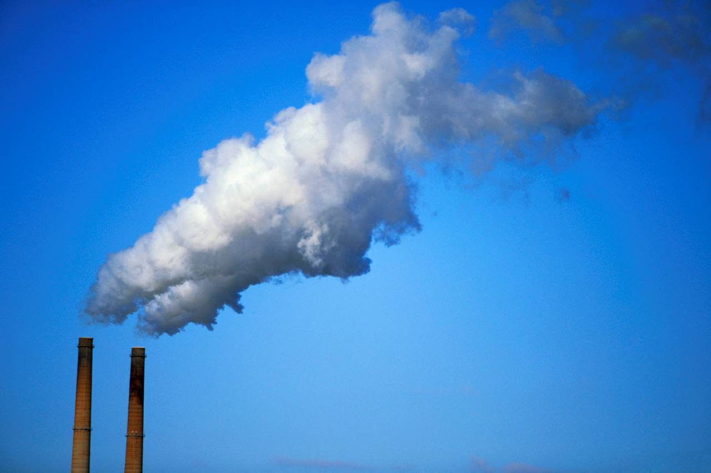
HSPH Capstone Project
Air Pollutant Models
Keyan Halperin
Chris Hase
Justin Lee
Casey Meehan
TF: D. Sondak

Slide 2


Our Partners
National Studies on
Air Pollution and Health (NSAPH)
PI: Prof. Francesca Dominici,
Harvard T.H. Chan School of Public Health

Slide 3

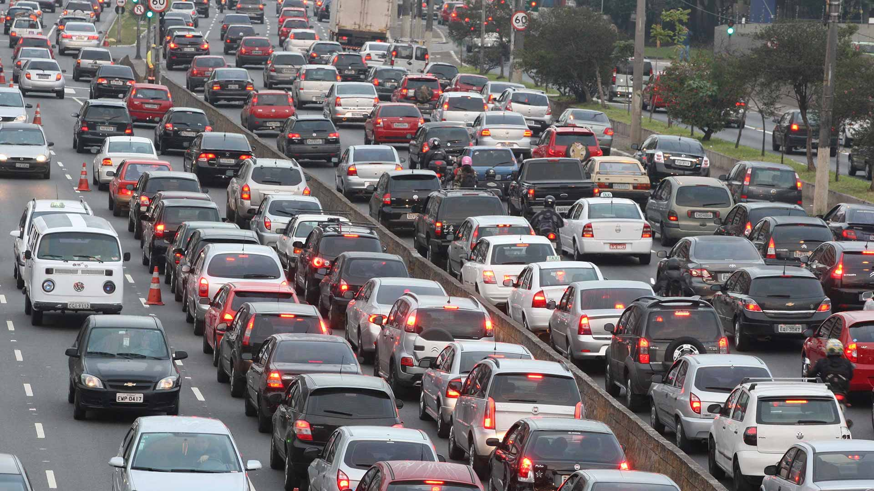


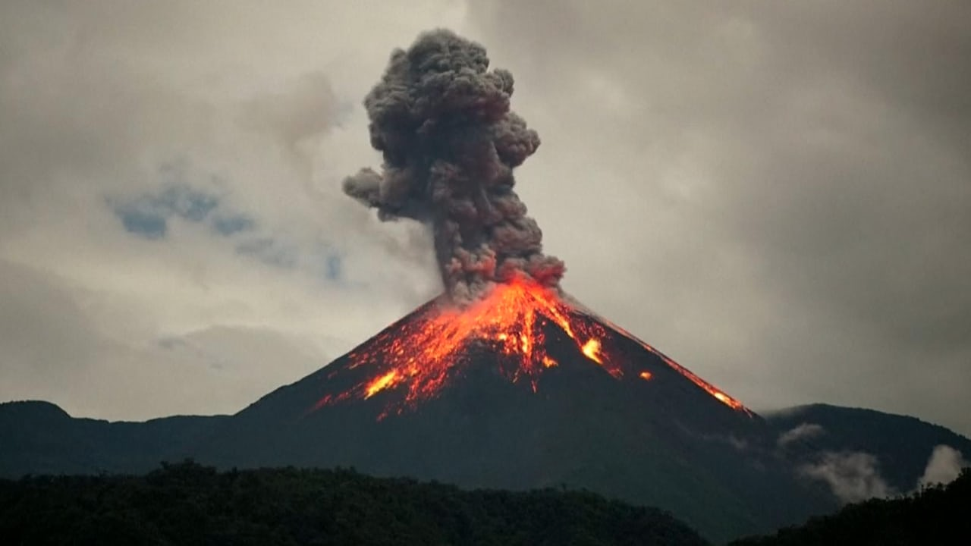
What’s the Problem?
Health Impacts
Causal Inferences
Project Scope

Slide 4
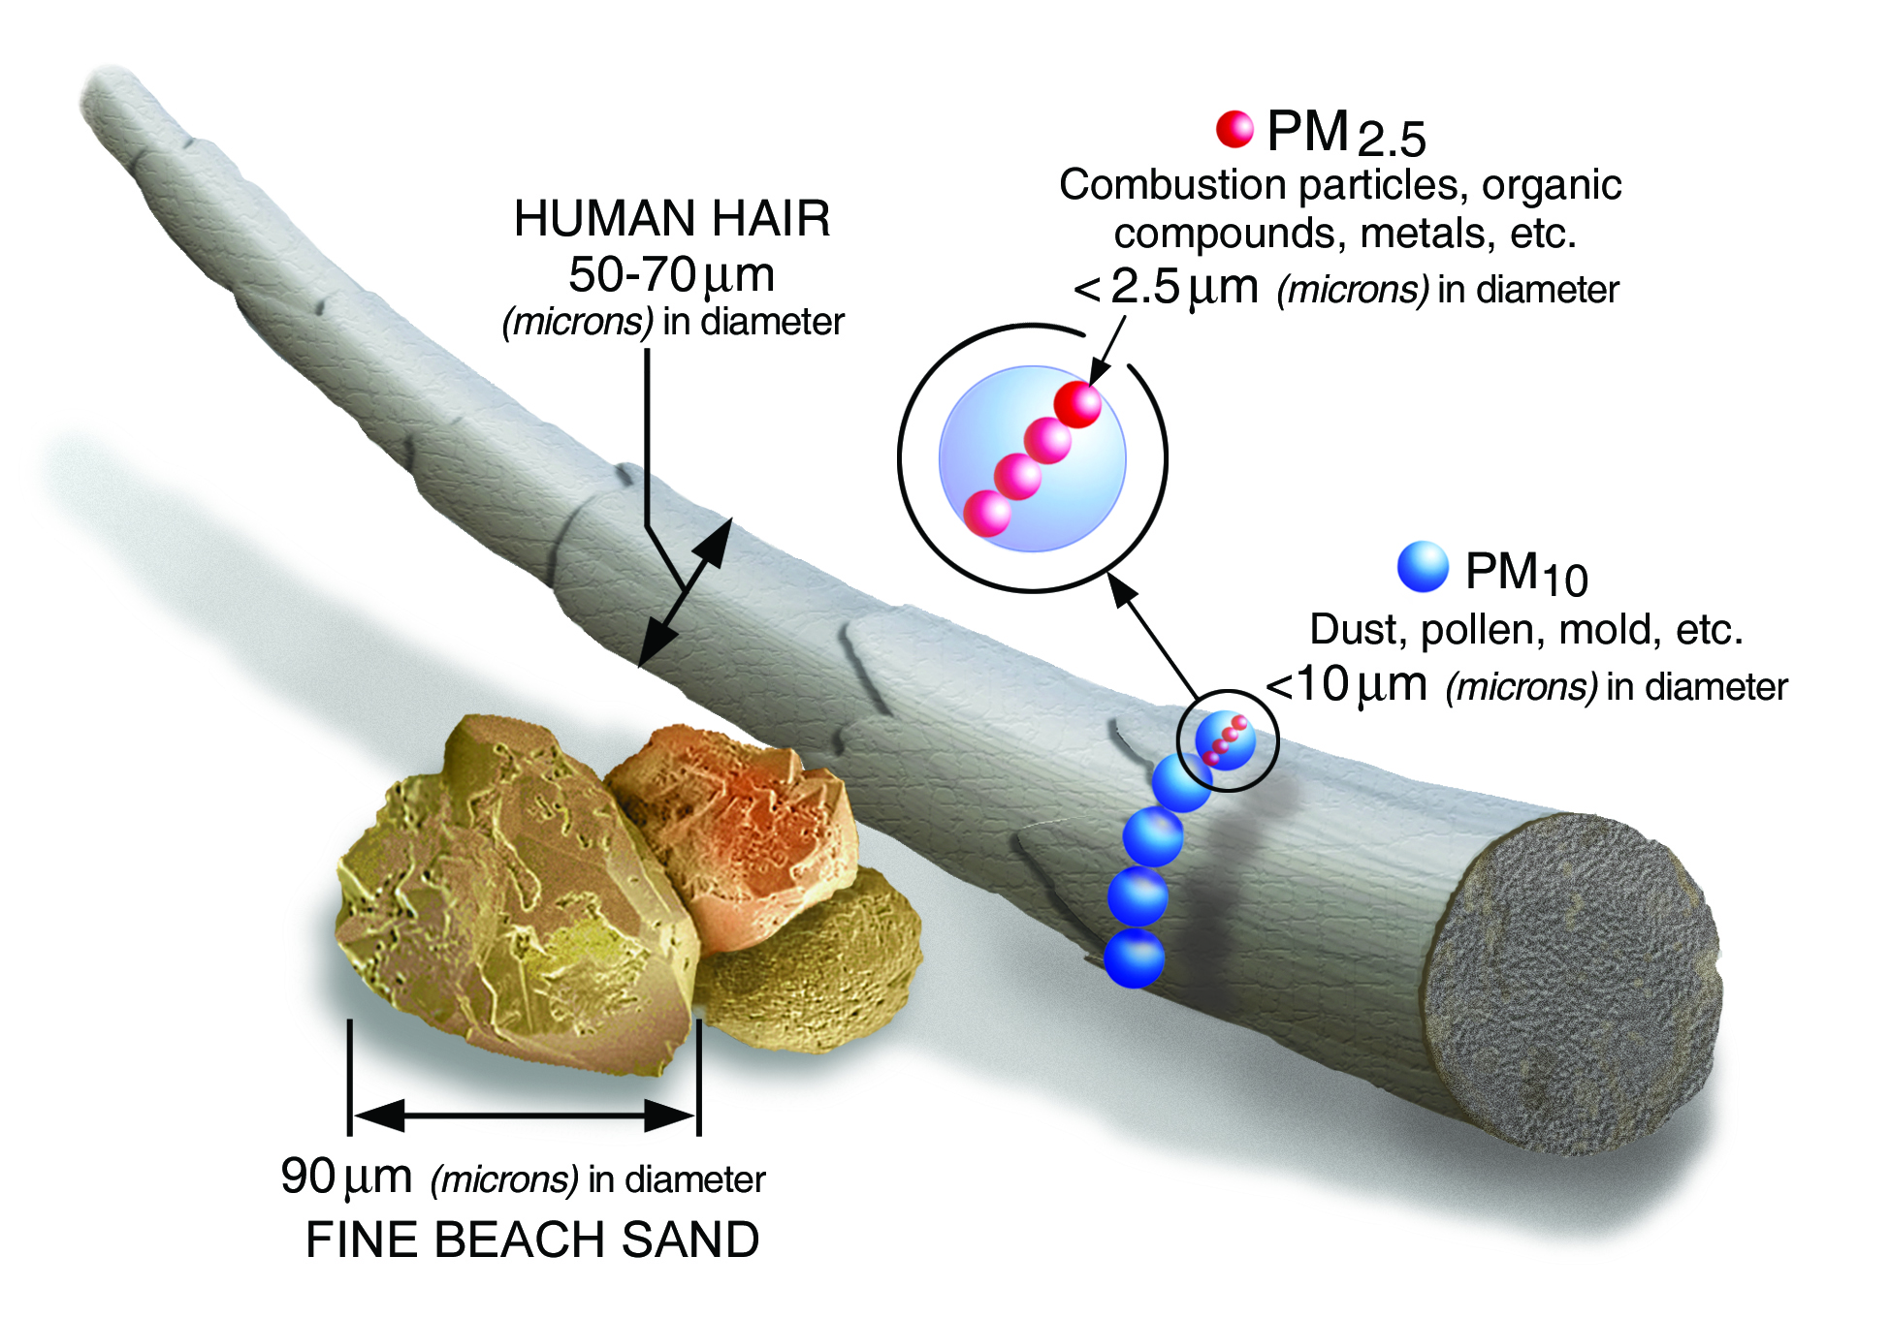
Pollution = Bad
Lung Cancer
Asthma
Heart Attack
Stroke
Notes:
We’re focused on particulate matter with a diameter less than 2.5 micron, PM2.5
Has been shown to contribute to a number of ailments
Both natural and manmade

Slide 5
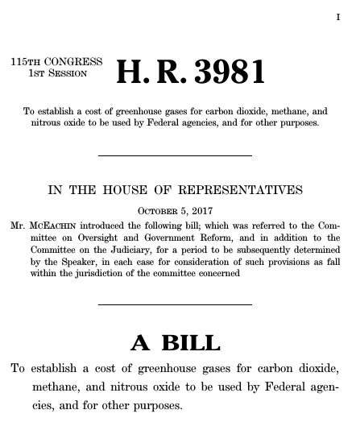
Taking Action
Notes:
For scientific purposes, it’s helpful to understand relationships between pollution and public health.
But uiltimately, an organization like HSPH wants to influence policy and provide guidelines

Slide 6
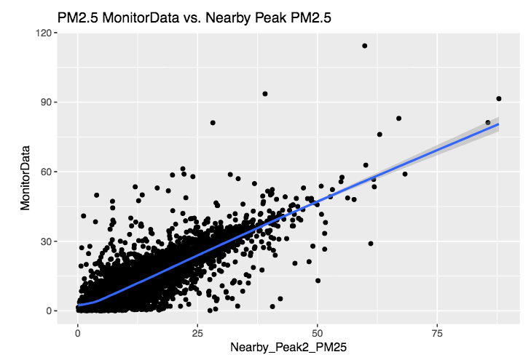
Correlation v. Causation
Notes:
For HSPH to demonstrate correlation between pollution and health outcomes is a well-defined task.
But, policy is motivated on causation, not correlation.

Slide 7
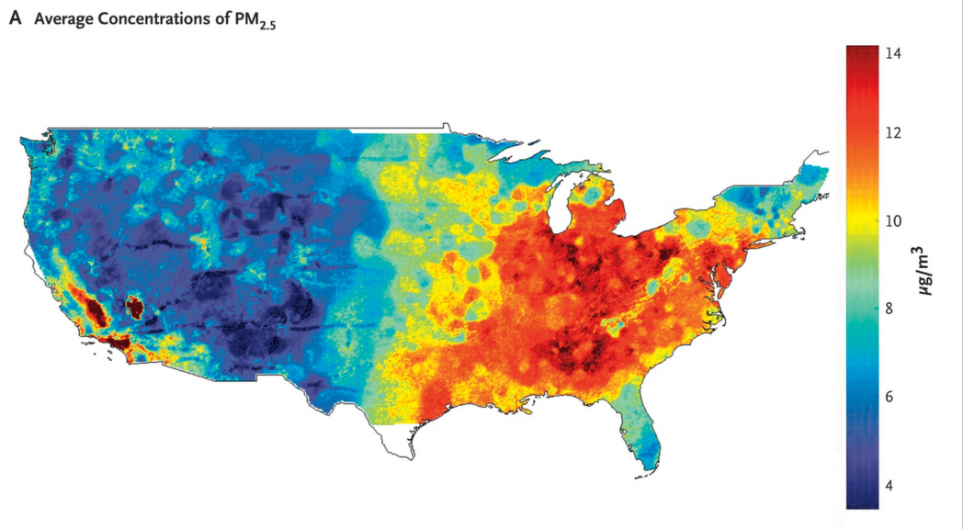
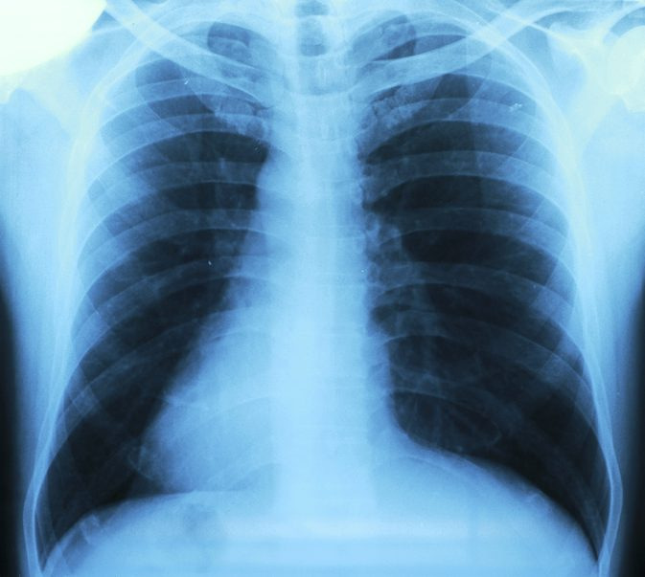
Causation, not Correlation
Notes:
We are NOT doing causal, our partners are
So HSPH’s preliminary goal is to estimate PM2.5 concentrations nationwide, like this heat map.
That said, their ultimate goal is to use these estimations to make causal inferences about health outcomes in the US.
As a consequence, it’s critical that these estimations are at least well-understood if not robust
If you don’t understand the pollution, you cannot understand what it’s causing

Slide 8
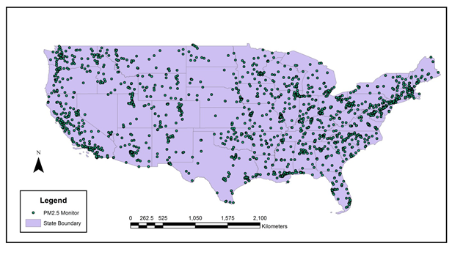
Building a Robust Map of Pollution
2,156 Monitors
16 yrs of measurements
Notes:
The scope of our project is to help estimating pollution nationwide.
starting from a map of 2156 PM2.5 sensors
Over the course of 16yrs

Slide 9
Building a Robust Map of Pollution
2,156 Monitors
16 yrs of measurements
Notes:
As we develop this map it’s important to consider that several areas are notably out-of-sample
We need to take extra caution not to overfit

Slide 10
Building a Robust Map of Pollution
Notes:
Because our partner wants to go from that grid of sensors to a completely filled-in heat-map

Slide 11
Building a Robust Map of Pollution
Notes:
And our partner wants to use that data to ultimately propose PM2.5’s impact on our community’s health

Slide 12
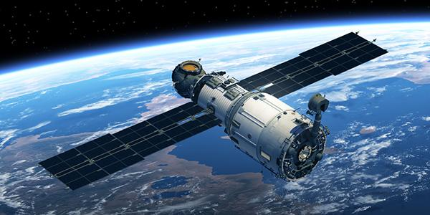
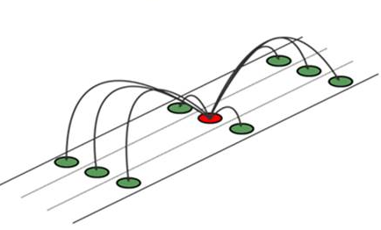

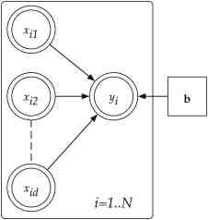
Where We Come In:
Augment our Predictors
Large-Scale Imputation
High-dim Variable Selection
Auxiliary Data
Notes:
In the task of building a robust pollution map, we plan to work on 3 key things
First, is working with the raw inputs to this model.
We’re provided with over 100 predictors from satellite measurements.
Due to environmental factors, there is serious missingness that must be imputed
Our partner suggested that imputation schemes have a big effect on model robustness, and needs to be cultivated
We aim to winnow down the key variables that we’re using. Losing redundant variables makes model-experimentation easier
Finally, we want to extend our predictors beyond satellite data, (e.g. census data)

Slide 13
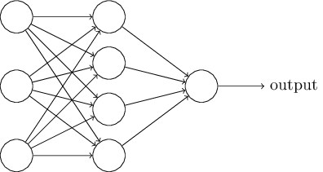
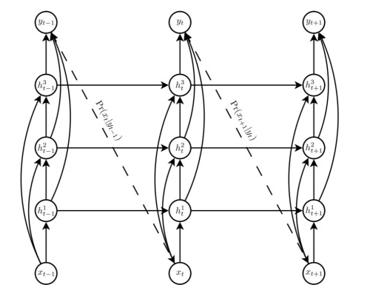
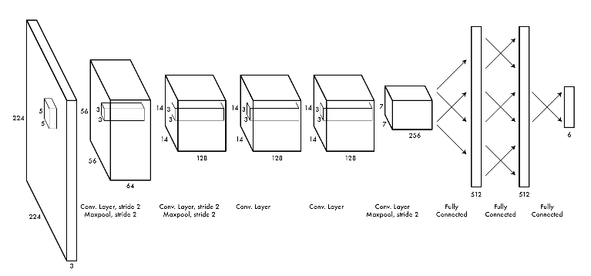
Where We Come In:
Experiment with Models
(Currently Feed-Forward)
RNNs
CNNs
Notes:
Additionally we are reconsidering the machinery we use to actually make predictions.
Currently model is FF,
Will likely benefit from new techniques

Slide 14
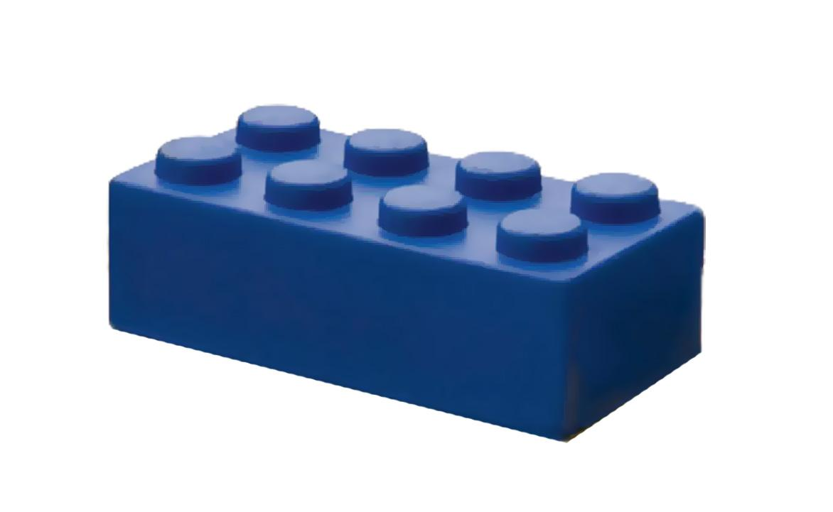

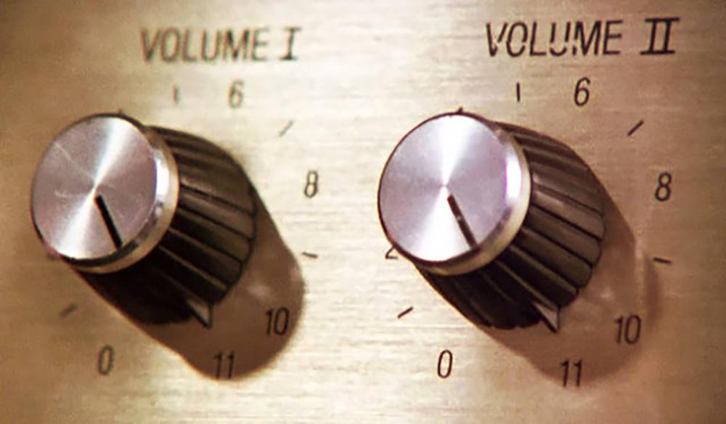
Where We Come In:
Offer an Extensible Design
Accepts new data
Key Parameter Tweaking
Notes:
Finally, the project code is currently only in a state to produce papers, no condition for making new experimentations
We plan to give them a modeling toolkit that will enable them to make future experiments
We’re hoping to build something that can incorporate any new data they find and provide key parameters for tweaking

Slide 15
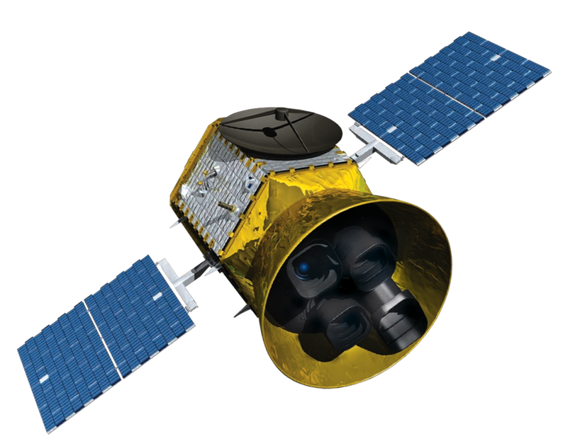
What are We Working With?
Imputation Problem
Existing Model
Notes:
Let’s talk about what our partners have handed over to us, the state of the project before we got started

Slide 16
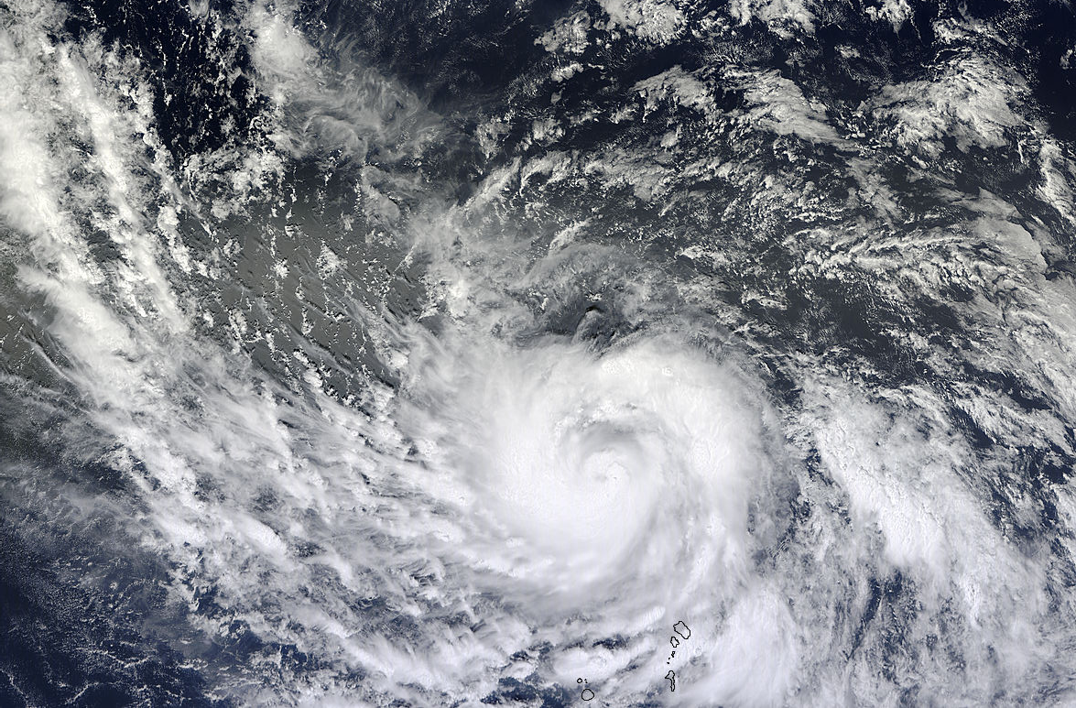
Given Data
16yrs
2156 Sites
Sensor Data
(Response)
Satellite Data
(Predictors)
13M PM2.5 Sensor-Days
~75% sensor-days missing
Defunded sites (costly)
115 measurements/day/site
Also severe missingness
Cloud cover
Snow reflection
Notes:
Making daily predictions
First, the data:
We have one response variable we’re trying to predict: PM2.5 concentration
Grand total of 13M sensor-days
BUT about 75% missing. Sites get defunded ~$1000/day
To predict the PM2.5 we have daily satellite measurements in high dimension: 115 different measurements per sensor site per day
Also has severe missingness for a number of environmental reasons

Slide 17
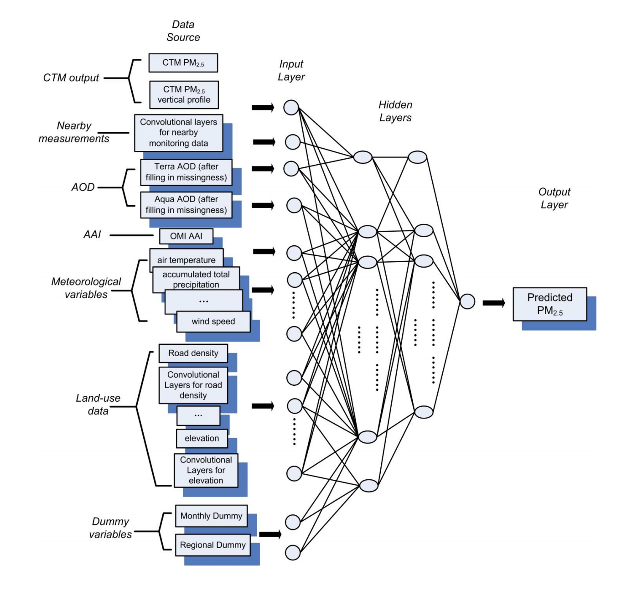
Existing Model - Functional, not Optimal?
Room for improvement:
Currently FF
(Could benefit from RNN)
Convolutional layers for alternative geographical data
Modular, legible, extensible code
Notes:
Model for existing published results
Our partner has built a FF NN for making PM2.5 predictions that we think we will improve on.
There are considerable temporal relations in pollution that a structure like an RNN could take advantage of
There are more convolutional inputs we can consider with geographic data
Finally, we’ll make it actually legible, runnable, usable

Slide 18

Looking at the Data
Exploratory Data Analysis
Feature Correlations
Baseline Models

Slide 19
EDA - Setup
~13.4 million rows total in sensor data
115 predictors, 1 response column
Took a random sample of 1% of the data (~134,000 rows) in order to perform exploratory data analysis
Simplified preliminary work in exploring data - proportions of missing data, correlations

Slide 20
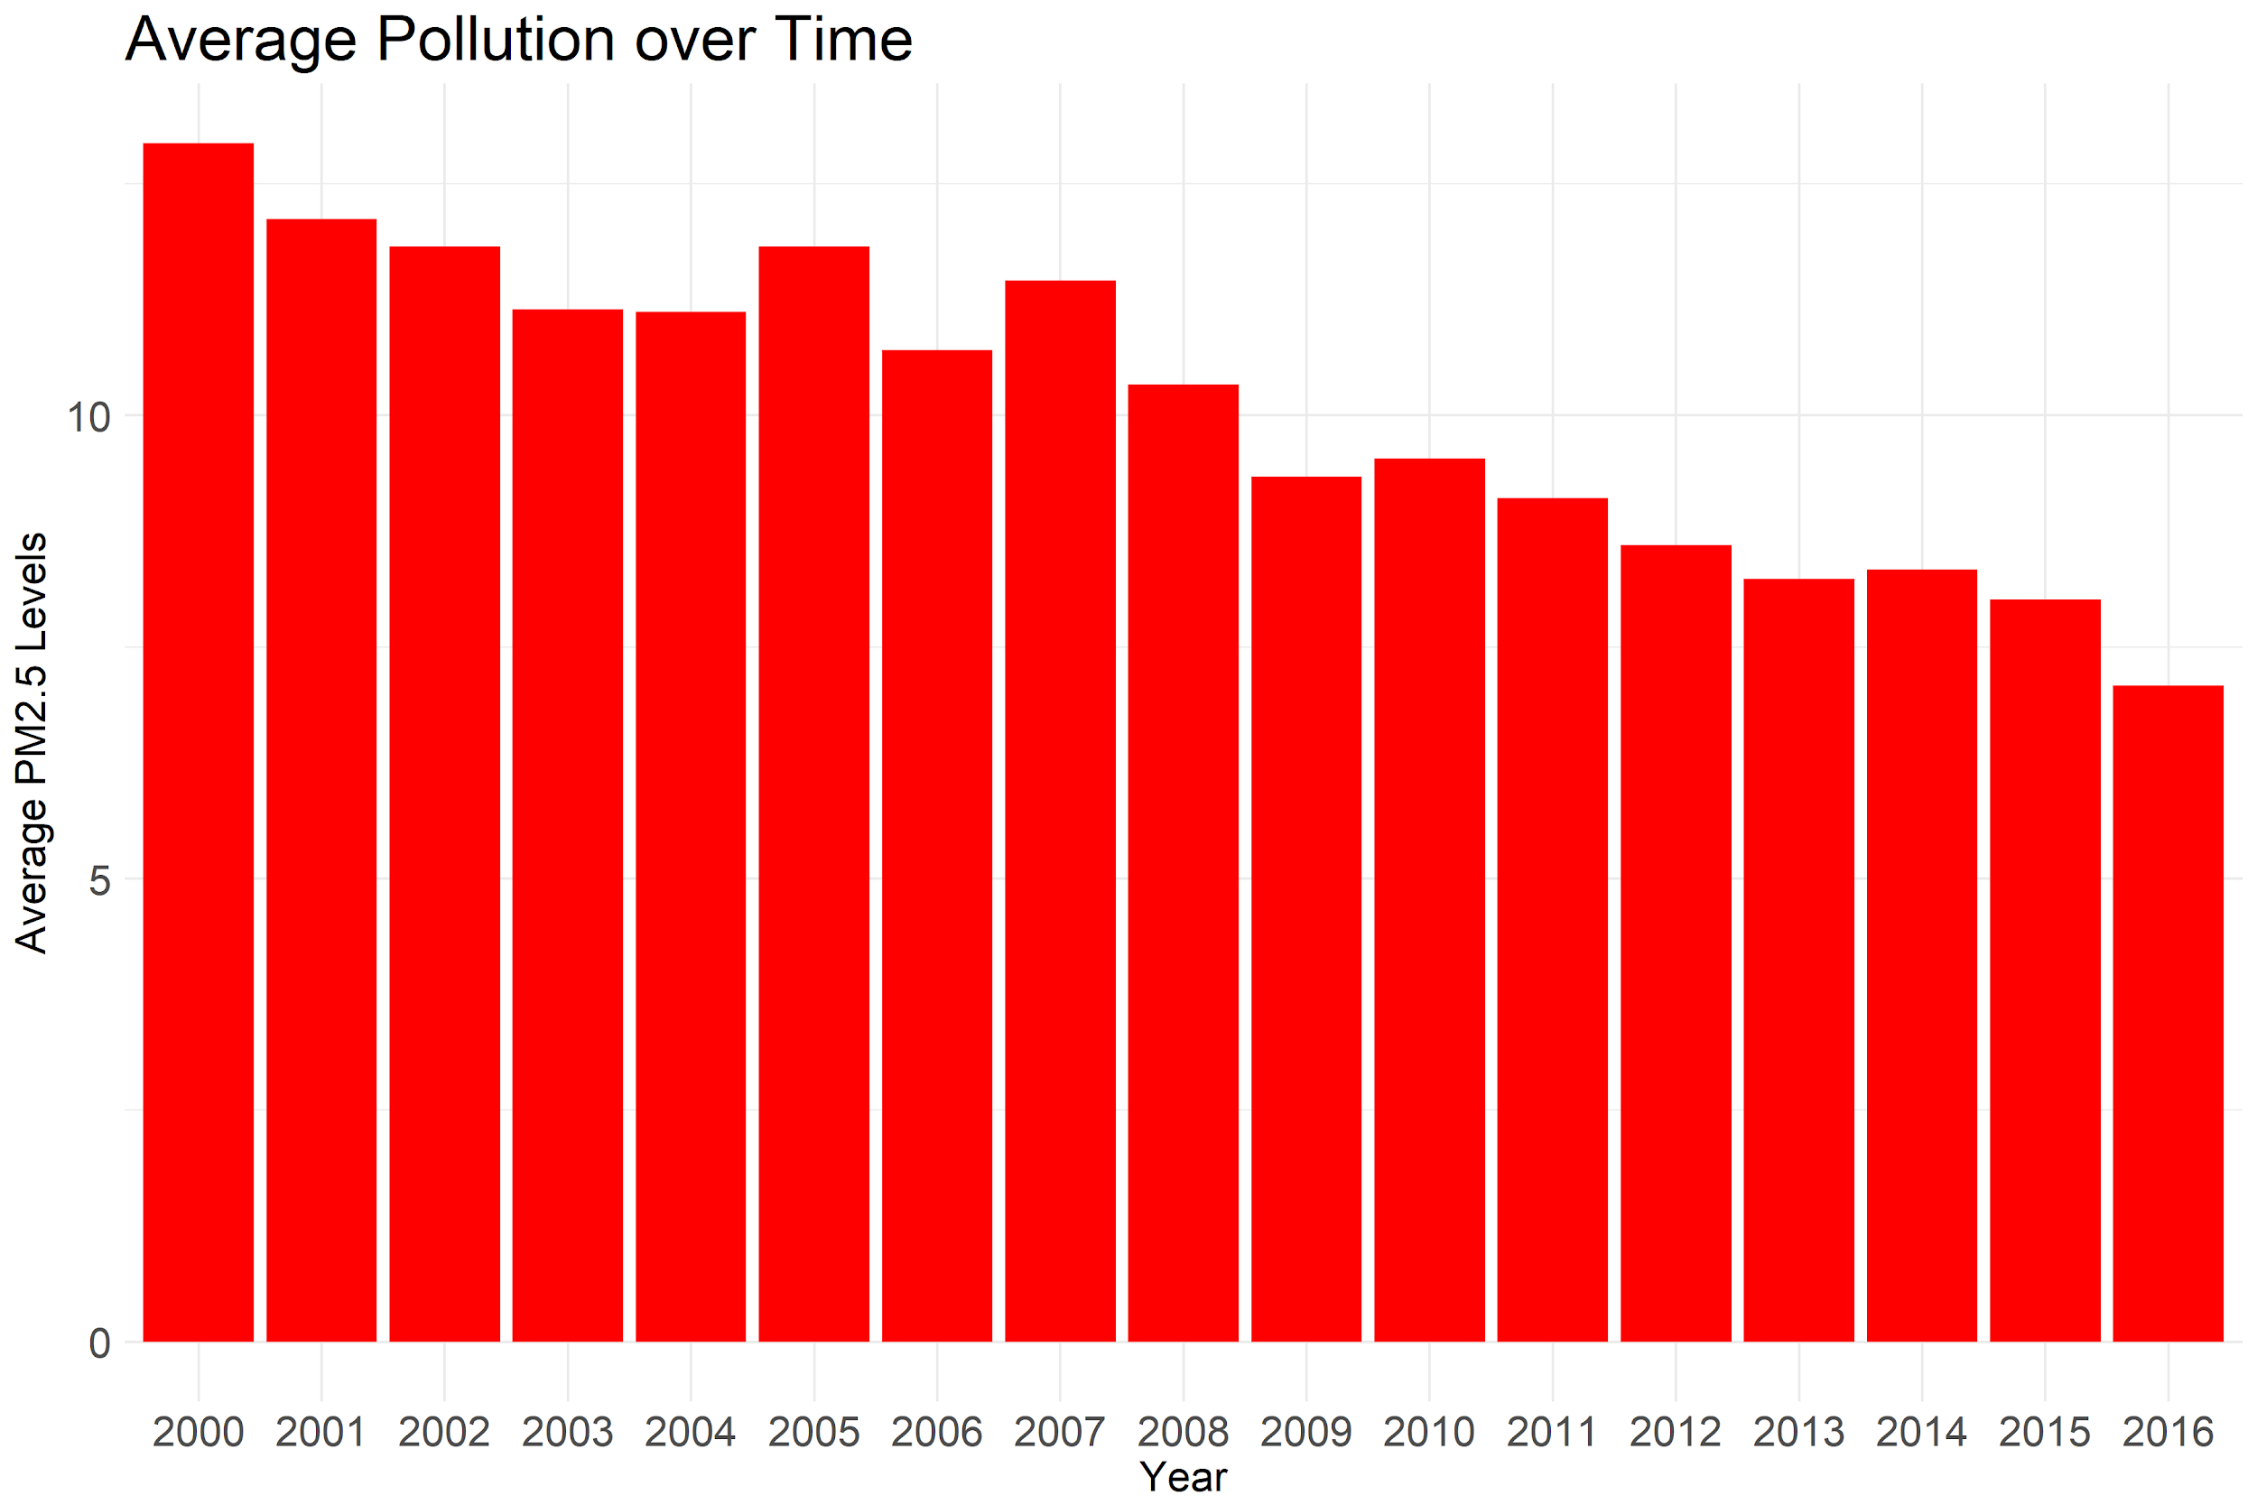
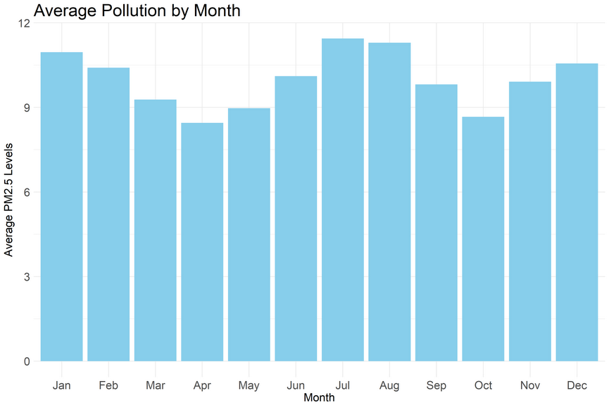
EDA - Pollution Over Time

Slide 21
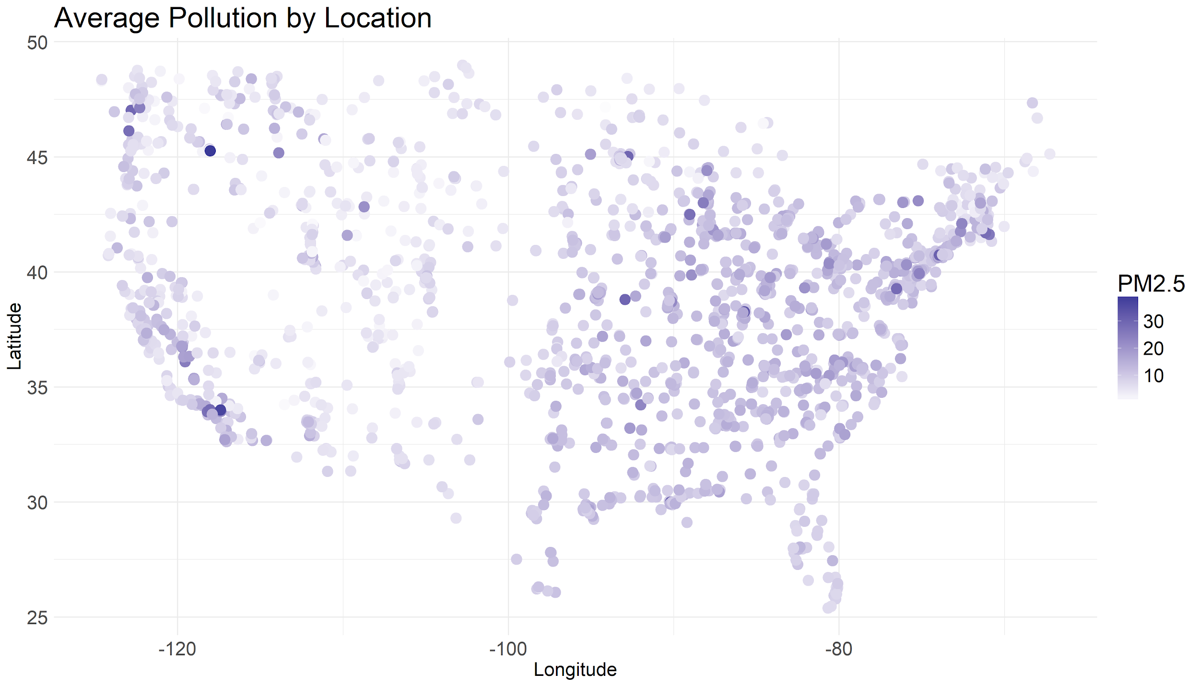
EDA - Pollution by Location

Slide 22
Pairwise Correlations - Groups
Category | Description | # Columns in Category
US Elevation | Statistics on elevation of site locations | 13
NLCD | National Land Cover Dataset | 16
Road Density | Statistics on presence of roads | 5
MAIAC | Aerosol Optical Depth | 6
REANALYSIS | Meteorological Data | 34
MOD11A1 | Surface temp, cloud cover | 4
Nearby Terms | Spatial/Temporal Nearby Terms | 18
OMAERO | Ozone Monitoring Instrument (OMI) Aerosol Product | 3

Slide 23
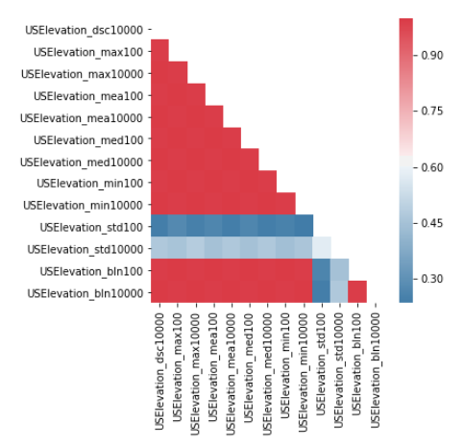
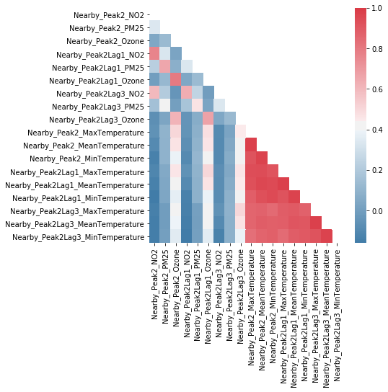
Pairwise Correlations

Slide 24
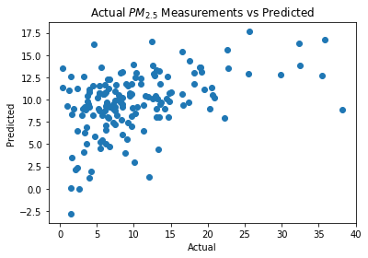
Baseline Model - LASSO
Only data from 2010 with non-missing response
Considered a subset of columns with low within-group pairwise correlation and low missing data proportion, plus location and month
Test R² of 0.192

Slide 25
Searching for Patterns

Slide 26
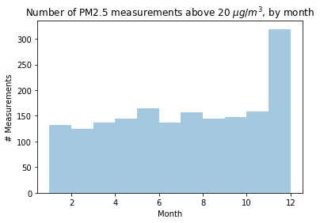
Searching for Patterns

Slide 27
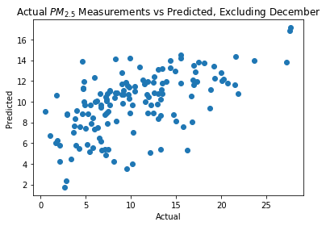
Baseline Model - LASSO ex. December
Same dataset as before, but excluding measurements from the month of December
Test R² of 0.331
Shows the need for a model that captures temporal dependencies

Slide 28
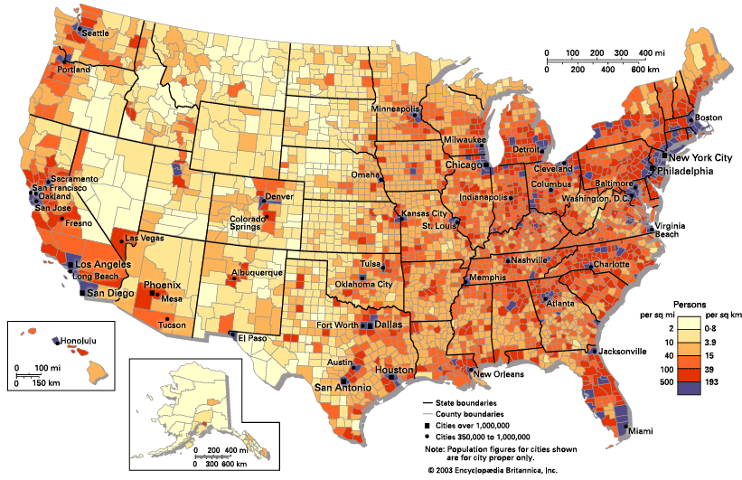
Incorporating External Data

Slide 29

Incorporating Census Data
We were able to obtain two things:
The longitude and latitude of each pollution sensor
US Census data by Zip Code
We then reverse geocoded the sensor locations to find which Zip code they were located in, in order to merge the pollution data with the Census data

Slide 30
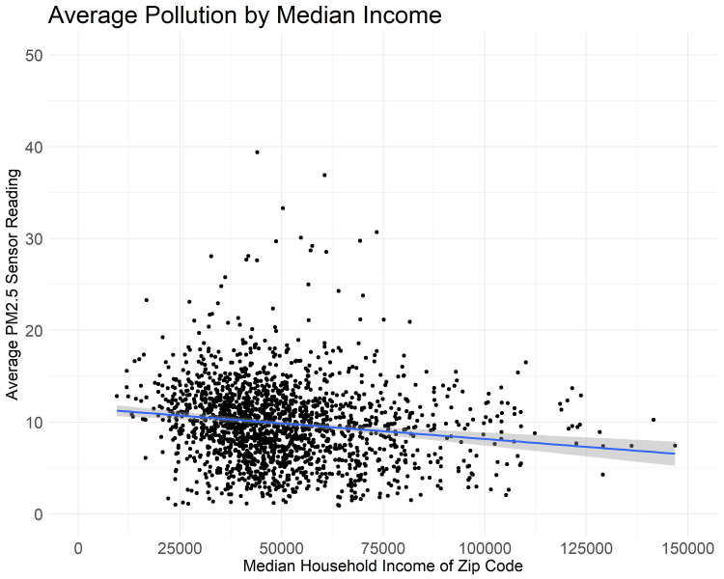
Census Data - Relationships

Slide 31
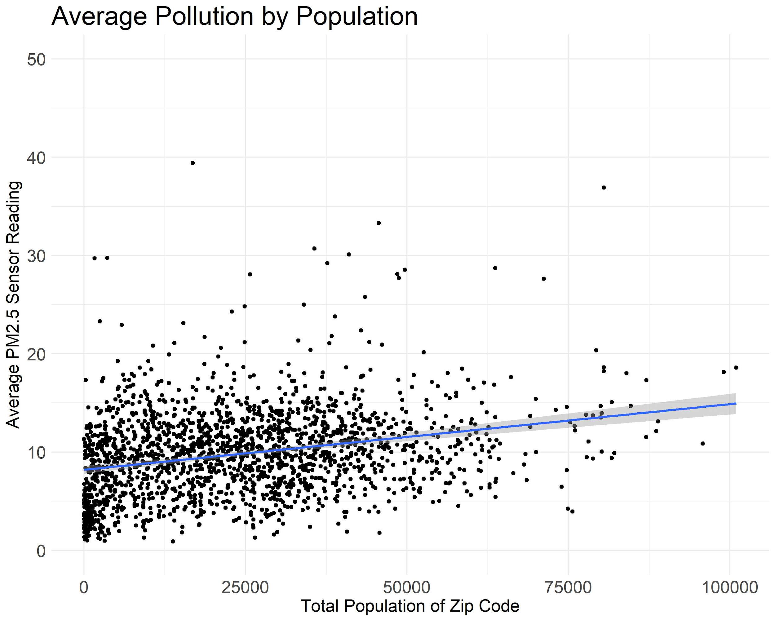
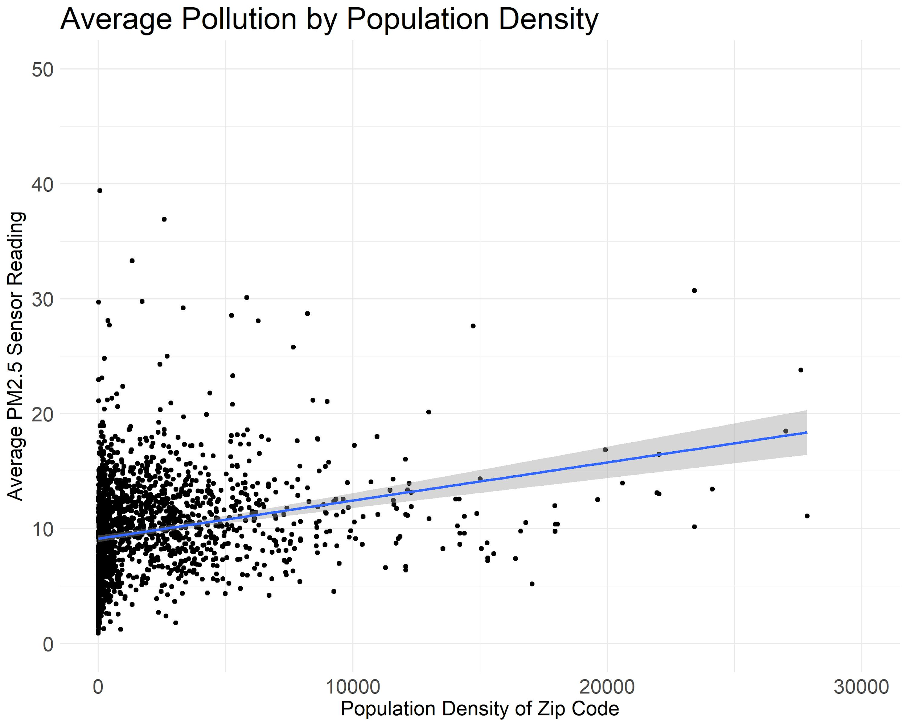
Census Data - Relationships

Slide 32
Pollution Sensor Locations

Slide 33
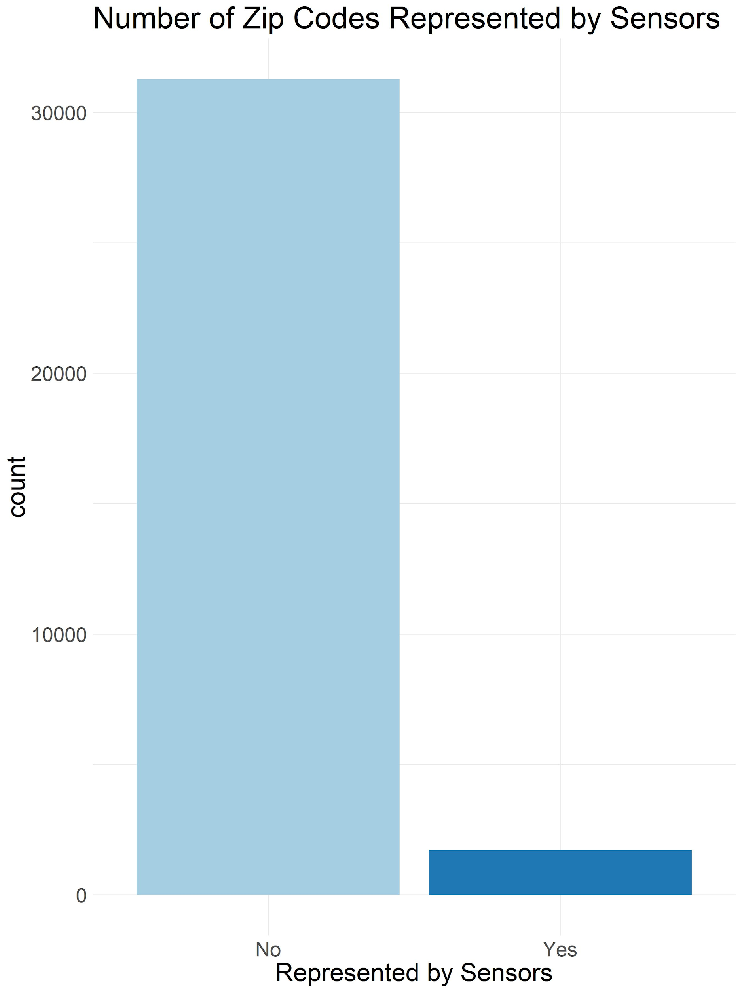
Census Data - Representativeness

Slide 34
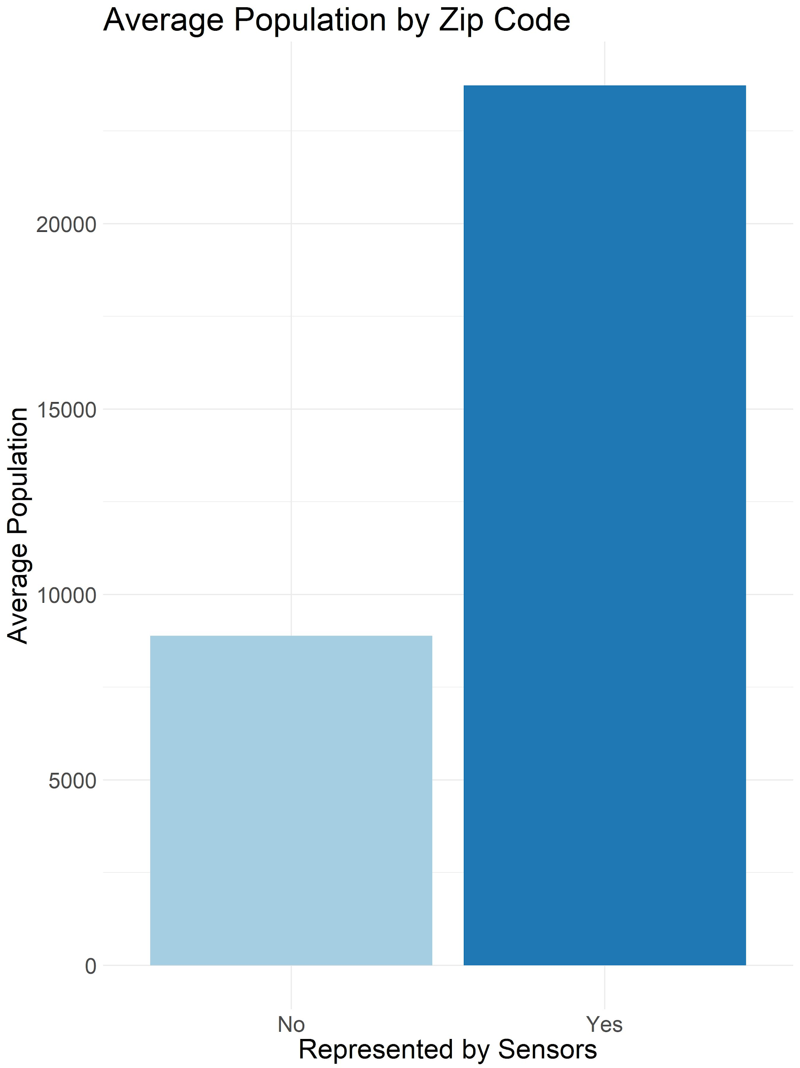
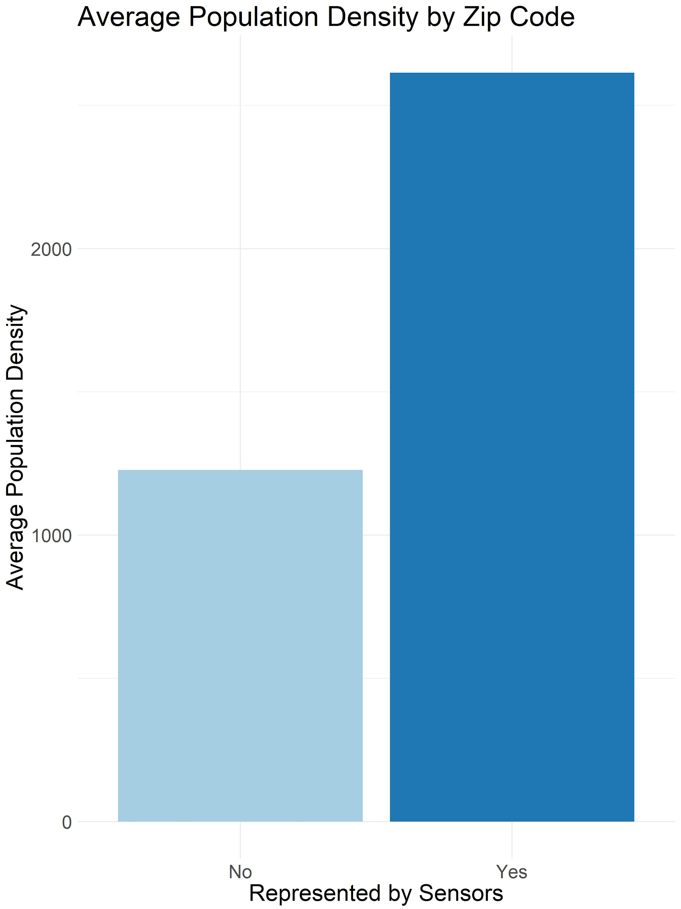
Census Data - Representativeness

Slide 35
Data Preprocessing
Missing Data
Dimensionality Reduction
Imputation

Slide 36
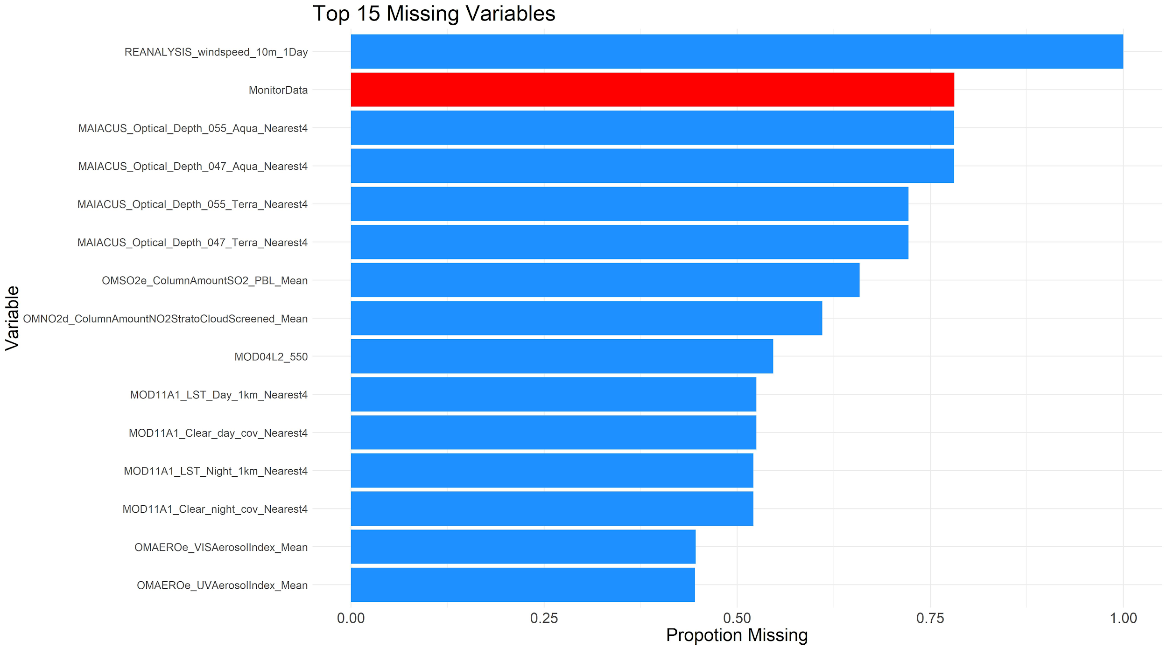
Missing Data

Slide 37
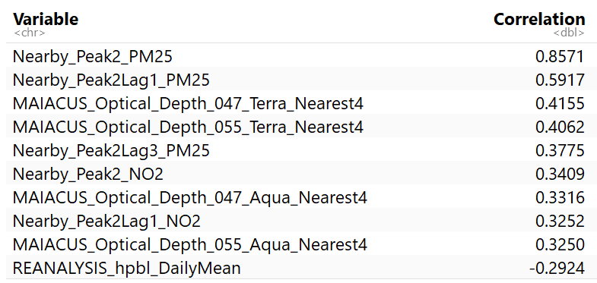
Missing Data

Slide 38
Dimensionality Reduction
For each pair of variables with greater than 0.9 correlation, drop one based on:
Correlation with response
Amount of missingness
Allowed us to drop 30 predictors
133 predictors remaining

Slide 39

Imputation Methods
Over 100 predictors with missing values need to be imputed prior to modeling
Currently, HSPH using linear models with a fixed subset of predictors that have little no missingness
Our attempts thus far:
Mean imputation
Iterative random forest imputation

Slide 40

Pollutant Modeling
Setup
Models Tested
Performance
Insights
Improvements

Slide 41
Modeling Setup
Randomly split sensors into train/test
~1500 train sensors yields ~12,000 train observations
~300 test sensors yields ~2,500 test observations
10-fold cross-validation with train data to tune hyperparameters
Optimizing for R²
Compare models’ test R²

Slide 42
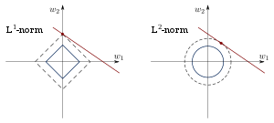
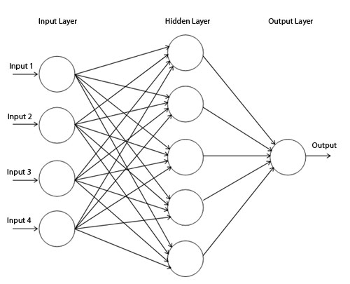
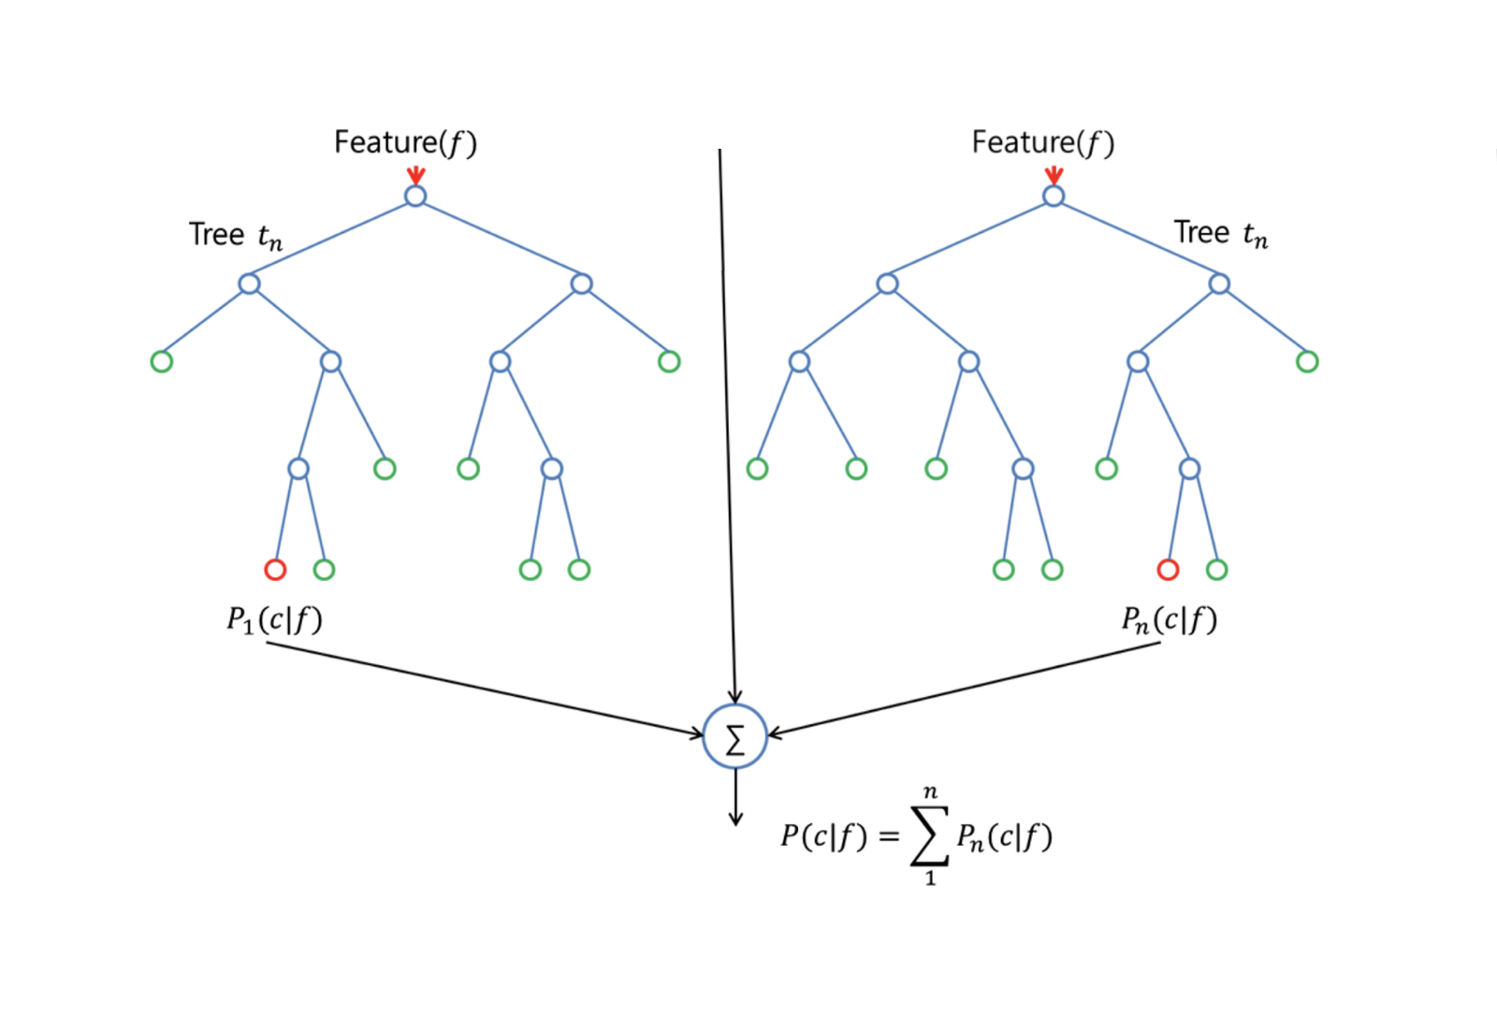
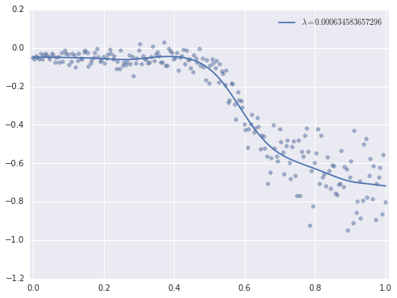
Models Tested
Lasso
Ridge
Random forest
Feed-forward NN
Generalized additive model

Slide 43
Model Test R² Results
Model / Imputation Method | Mean | Random Forest
Ridge | 0.765 | 0.767
Lasso | 0.764 | 0.767
Generalized Additive | 0.771 | 0.772
Random Forest | 0.782 | 0.787
Feed-forward NN | 0.735 | 0.74
Notes:
Huge jump from 0.33 after inclusion of temporal, spatial, census information as well as more variable selection and imputation
Basically the same results for different models; NN does slightly worse
Random forest impute basically not any better; very slight improvement
Random forest model does best for both mean and random forest imputation

Slide 44
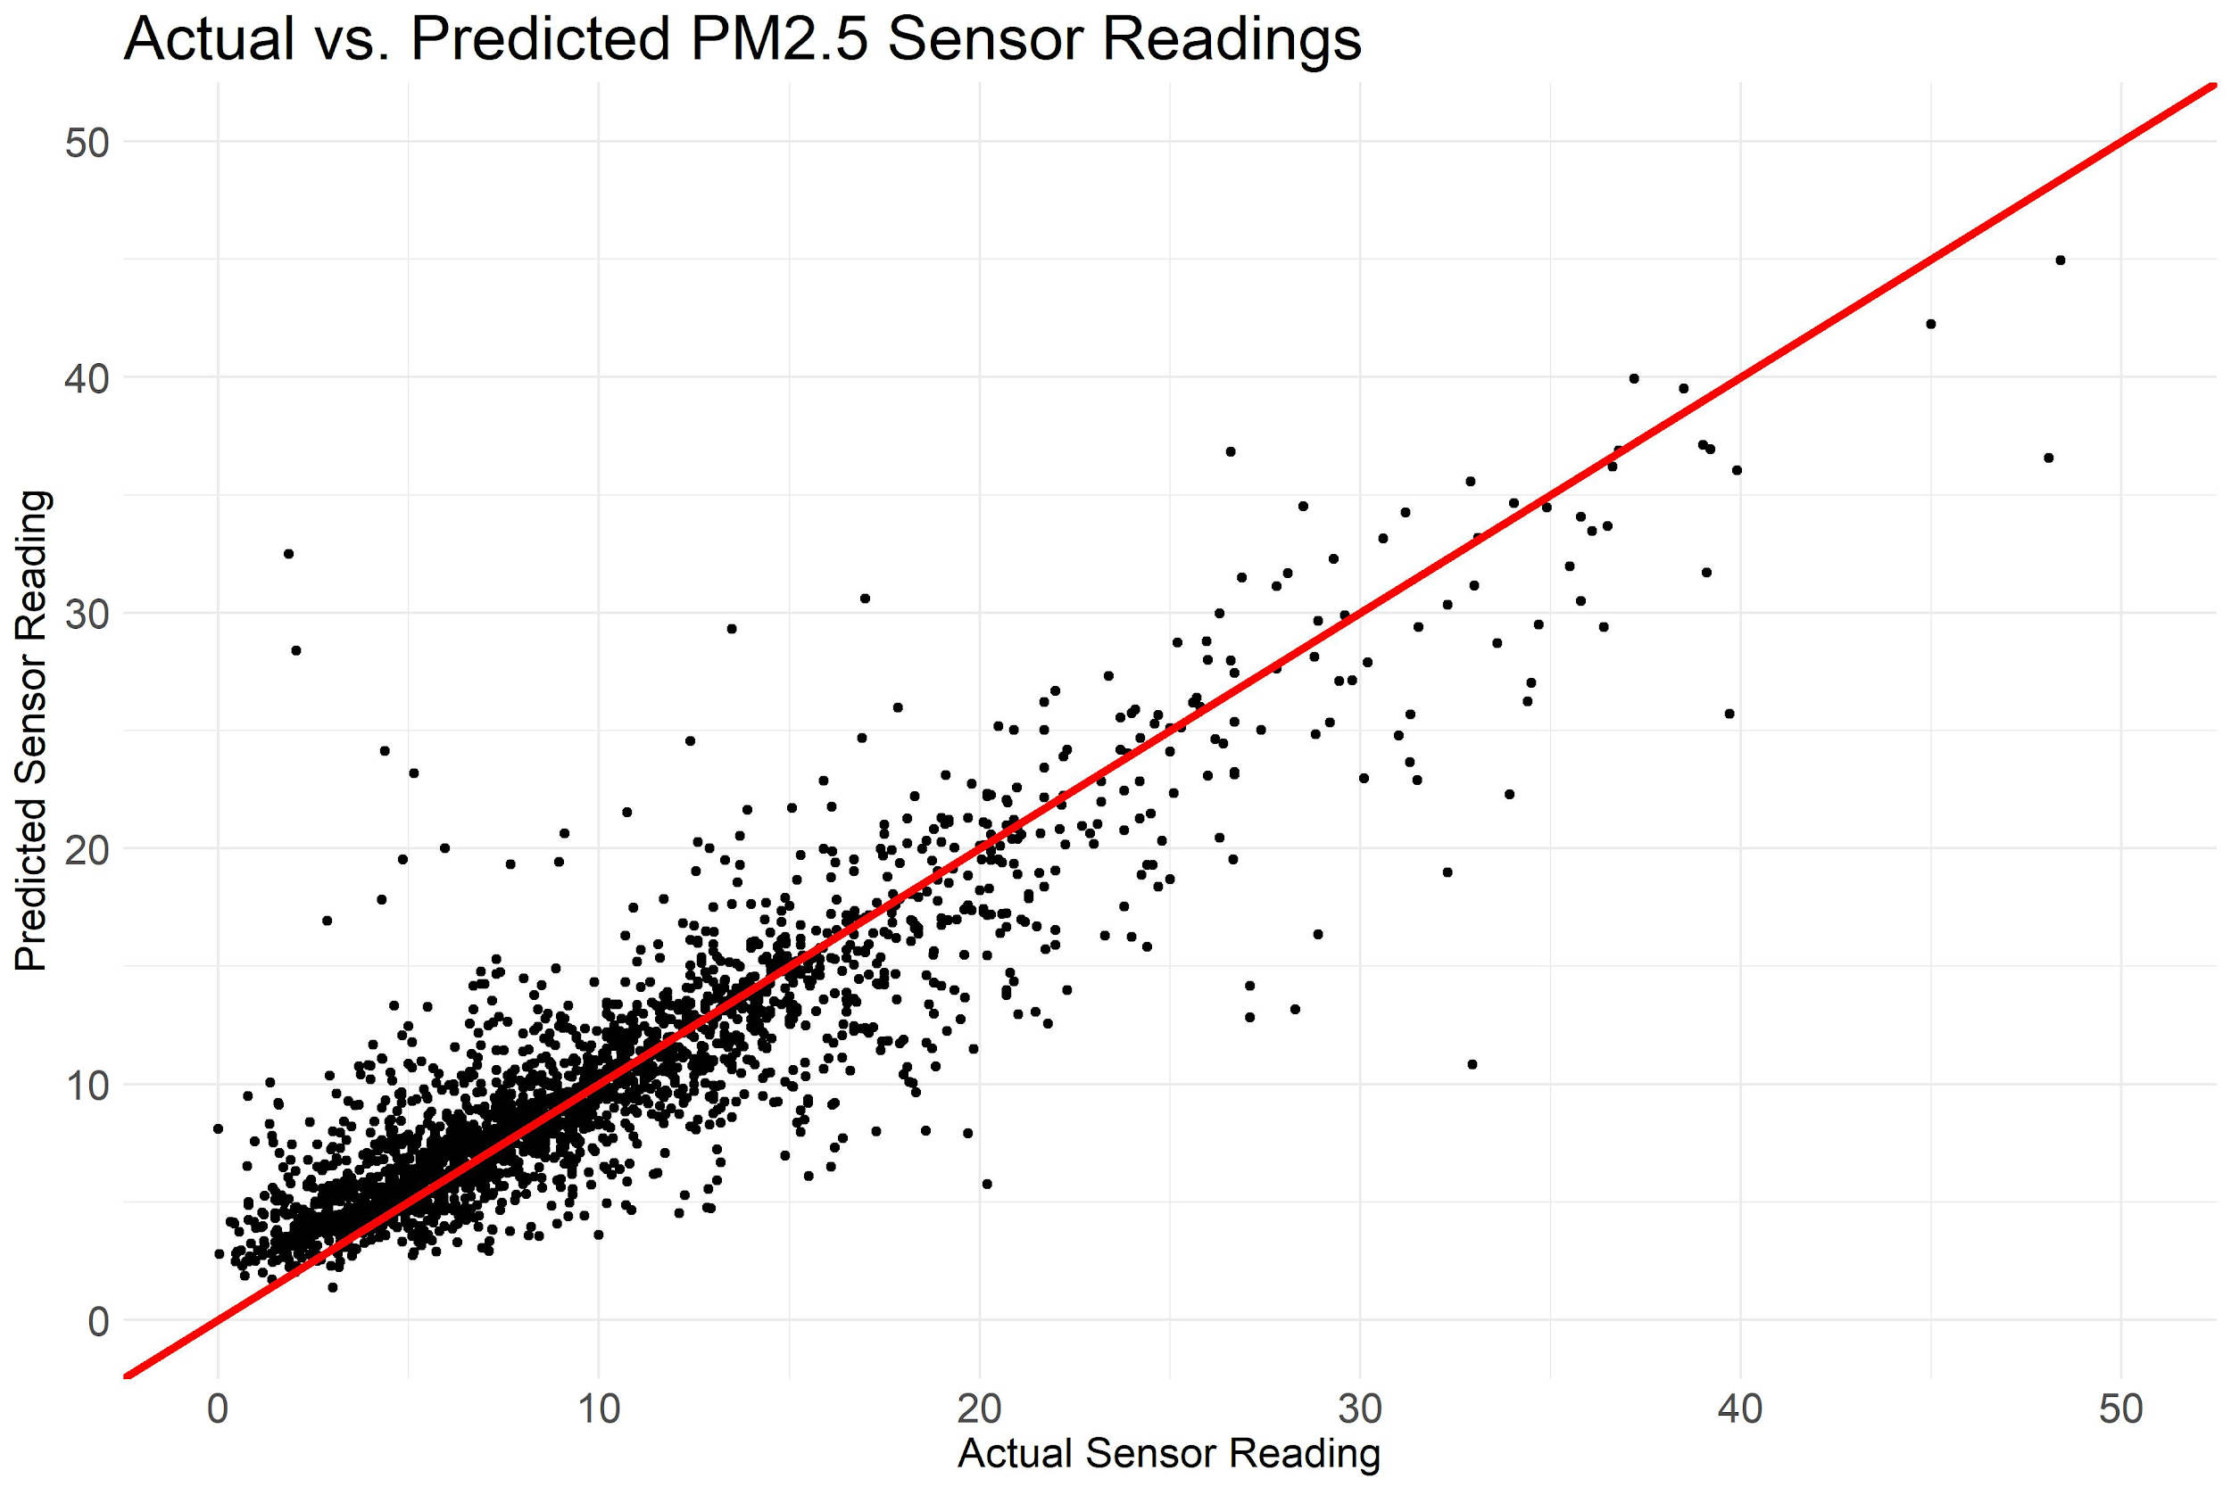
Best Model - Actual vs. Predicted

Slide 45
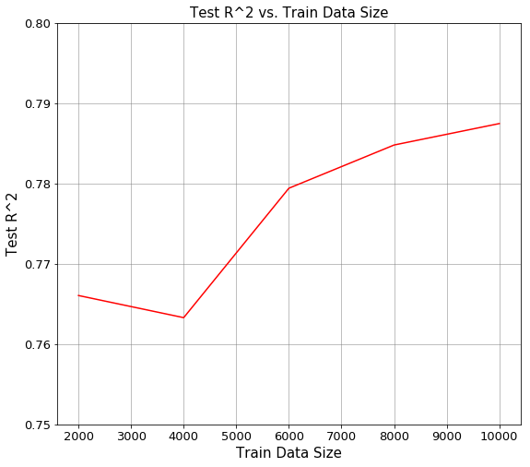
Modeling Insights
Important predictors
Vegetation of nearby areas
Nearby Peak Ozone

Slide 46
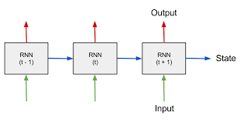
Improvements
Use ‘big data’
Evidence to suggest that the model R² will improve by using more data
Info within sensor sequence can help for imputation and modeling
Model complexity
RNNs and CNNs can learn complex temporal relationships within sensor sequences
CNNs can learn complex spatial relationships between nearby sensors

Slide 47

Looking Ahead
Deliverables
Nice to Have’s
Timeline

Slide 48

Deliverables
Optimal imputation software for overcoming serious missingness
Improved predictive model, incorporating auxiliary data
Extensible package for HSPH to use moving forward

Slide 49
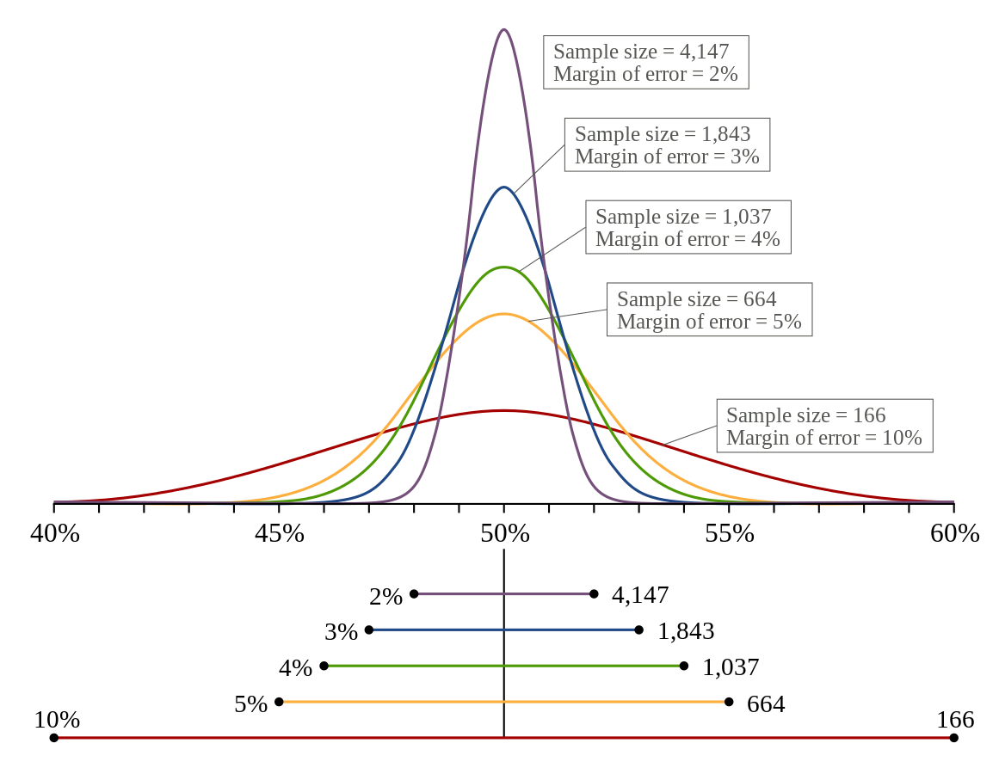
Nice to Have’s
Uncertainty quantification of model across map
Considerations of optimal new sensor locations

Slide 50
Timeline
April 1: Synopsis of Model Improvements
April 30: Model Accuracy Report
May 6: Packaged SW & Documentation

Slide 51

Thank you!

